Slide 1
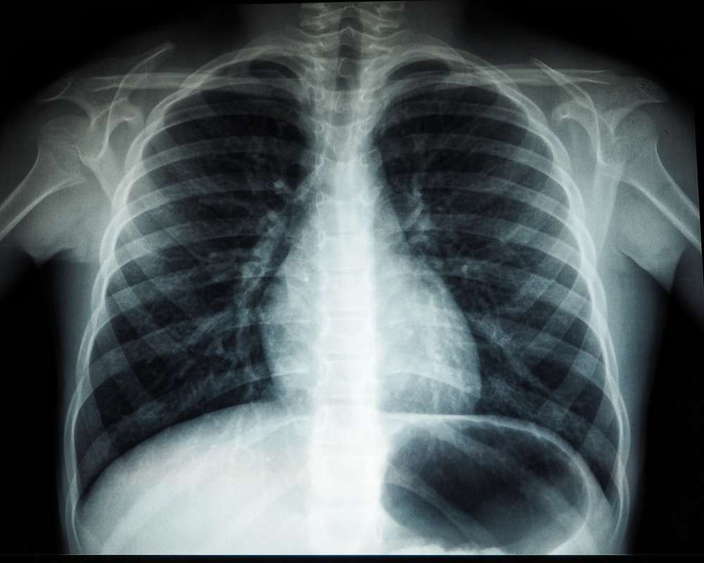
BY: Med-X (Team 1)
CS691
February 2024
Notes:
Do not delete this slide. It is a part of the animation for the 2nd page.

Slide 2
BY: Med-X (Team 1)
CS691
March 2024

Slide 3

AGENDA:
01
02
03
04
05
Sprint 1
Recap:
Member Names
Roles and Responsibilities
Improvements
Project Description
Team Working Agreement
Personas
Project Overview:
MVP
Languages and Tools
Algorithms
Diagrams
Backlogs:
User Stories
Acceptance Criteria
Sprint 2 Stories
Test Cases
Story Completion
Team Metrics:
Team Velocity
Burndown Charts
Retrospective
Product:
Sprint 3 Stories
Application Screenshots
API
Live Application Demo

Slide 4
AGENDA:
01
02
03
04
05
Sprint 1
Recap:
Member Names
Roles and Responsibilities
Improvements
Project Description
Team Working Agreement
Personas
Project Overview:
MVP
Languages and Tools
Algorithms
Diagrams
Backlogs:
User Stories
Acceptance Criteria
Sprint 2 Stories
Test Cases
Story Completion
Team Metrics:
Team Velocity
Burndown Charts
Retrospective
Product:
Sprint 3 Stories
Application Screenshots
API
Live Application Demo

Slide 5
AGENDA:
01
02
03
04
05
Sprint 1
Recap:
Member Names
Roles and Responsibilities
Improvements
Project Description
Team Working Agreement
Personas
Project Overview:
MVP
Languages and Tools
Algorithms
Diagrams
Backlogs:
User Stories
Acceptance Criteria
Sprint 2 Stories
Test Cases
Story Completion
Team Metrics:
Team Velocity
Burndown Charts
Retrospective
Product:
Sprint 3 Stories
Application Screenshots
API
Live Application Demo

Slide 6
AGENDA:
01
02
03
04
05
Sprint 1
Recap:
Member Names
Roles and Responsibilities
Improvements
Project Description
Team Working Agreement
Personas
Project Overview:
MVP
Languages and Tools
Algorithms
Diagrams
Backlogs:
User Stories
Acceptance Criteria
Sprint 2 Stories
Test Cases
Story Completion
Team Metrics:
Team Velocity
Burndown Charts
Retrospective
Product:
Sprint 3 Stories
Application Screenshots
API
Live Application Demo

Slide 7
AGENDA:
01
02
03
04
05
Sprint 1
Recap:
Member Names
Roles and Responsibilities
Improvements
Project Description
Team Working Agreement
Personas
Project Overview:
MVP
Languages and Tools
Algorithms
Diagrams
Backlogs:
User Stories
Acceptance Criteria
Sprint 2 Stories
Test Cases
Story Completion
Team Metrics:
Team Velocity
Burndown Charts
Retrospective
Product:
Sprint 3 Stories
Application Screenshots
API
Live Application Demo

Slide 8
AGENDA:
01
02
03
04
05
Sprint 1
Recap:
Member Names
Roles and Responsibilities
Improvements
Project Description
Team Working Agreement
Personas
Project Overview:
MVP
Languages and Tools
Algorithms
Diagrams
Backlogs:
User Stories
Acceptance Criteria
Sprint 2 Stories
Test Cases
Story Completion
Team Metrics:
Team Velocity
Burndown Charts
Retrospective
Product:
Sprint 3 Stories
Application Screenshots
API
Live Application Demo

Slide 9



Team Roles and Responsibilities
Ronaldo Simbaña
Scrum Master | Developer
Marla Capistran
Team Leader | Database Admin
Filippo Zallocco
Developer

Slide 10


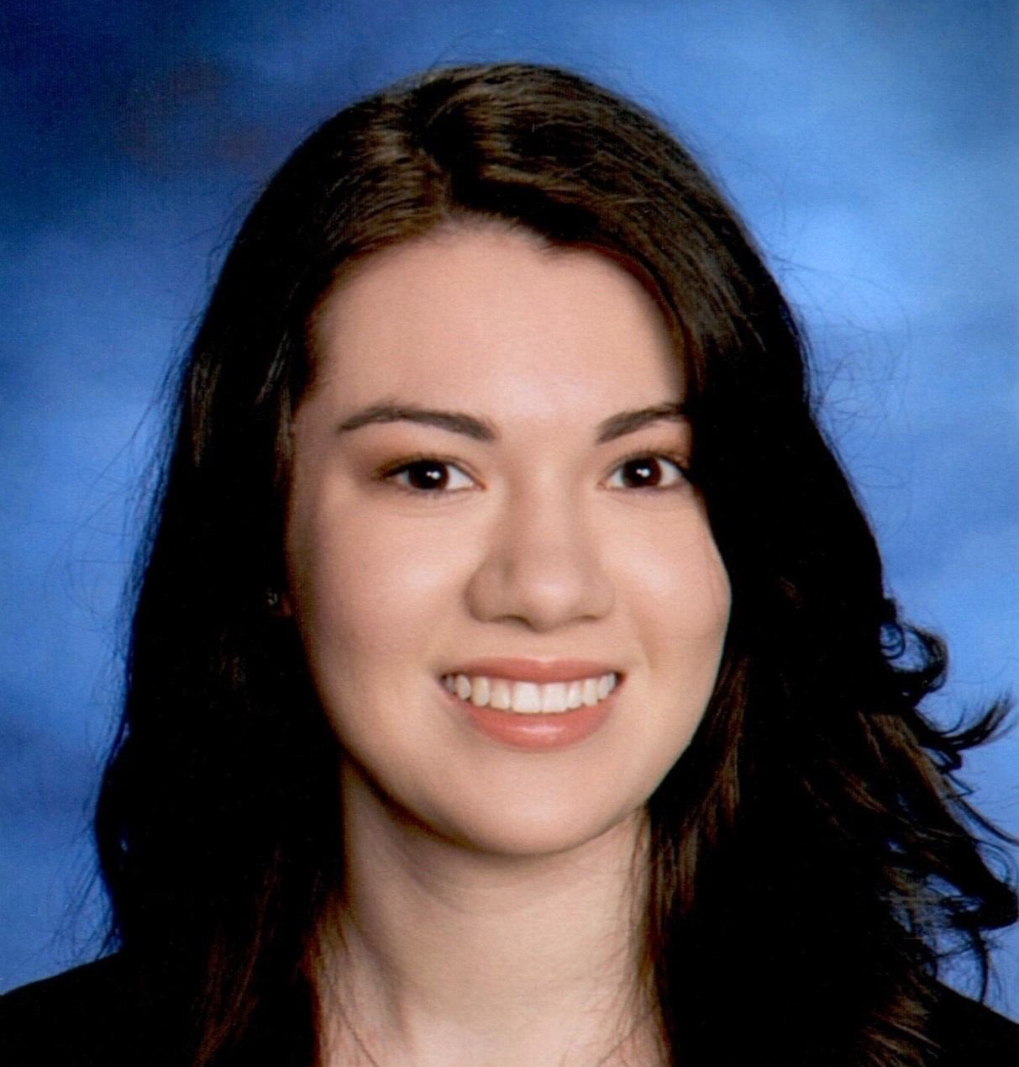
Team Roles and Responsibilities
Christopher Ospina
Developer
Anthony Muñoz
Quality Assurance / Tester Developer
Leanna Machado
Developer

Slide 11


Team Roles and Responsibilities
Rahul Nayanegali
Developer
Prithvi Raimangya
Designer | Developer

Slide 12
Improvements
Team Roles and Responsibilities were updated to reflect Developer roles as well (slides 9-11)
Project Description Page Added (slide 15)
Changed Product Design Journey to Product Discovery (slide 21)
Simplified MVP Design (slides 23,24)
Technologies and Algorithms explanation Added (slide 30-32)
Star indicates an improvement made

Slide 13
Problem Statement
Currently, x-ray machines are widely available; however, clinical chest x-ray images can be challenging to read and diagnose. Furthermore, x-rays are not a priority for radiologists, as they tend to focus more on CT images and MRIs. CT scans are both harmful and expensive, in addition to being time consuming.

Slide 14
Project Description
A web app that has a highly trained deep learning model that classifies x-ray images, reducing the need for a radiologist to examine them
Intended for medical professionals and patients who upload x-ray chest images
Uses a deep-neural network models that will detect common health issues
Our application will reduce the time it takes for a patient to receive their diagnosis using AI
Notes:
We could mention that x-rays are comparatively less hazardous, less expensive, and less time-consuming than CT scan images.

Slide 15
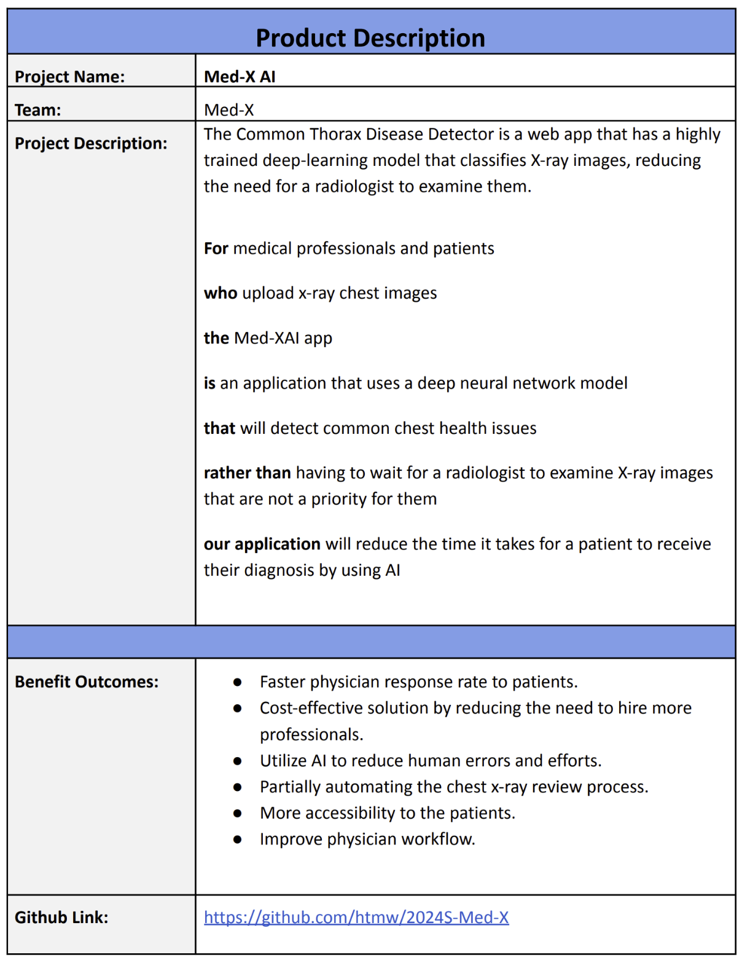
Project Description

Slide 16
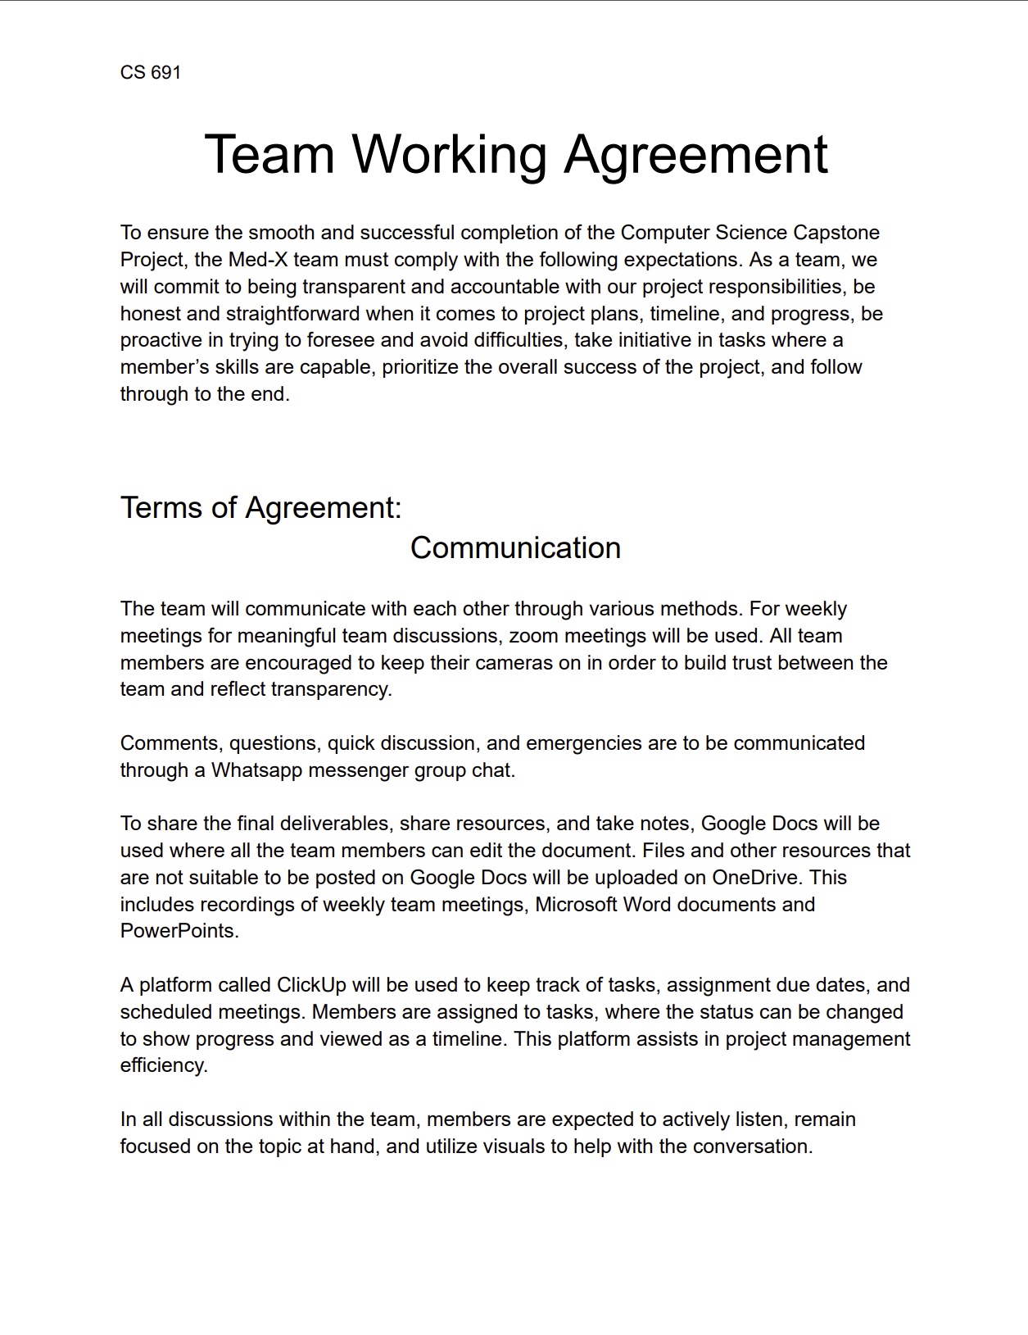
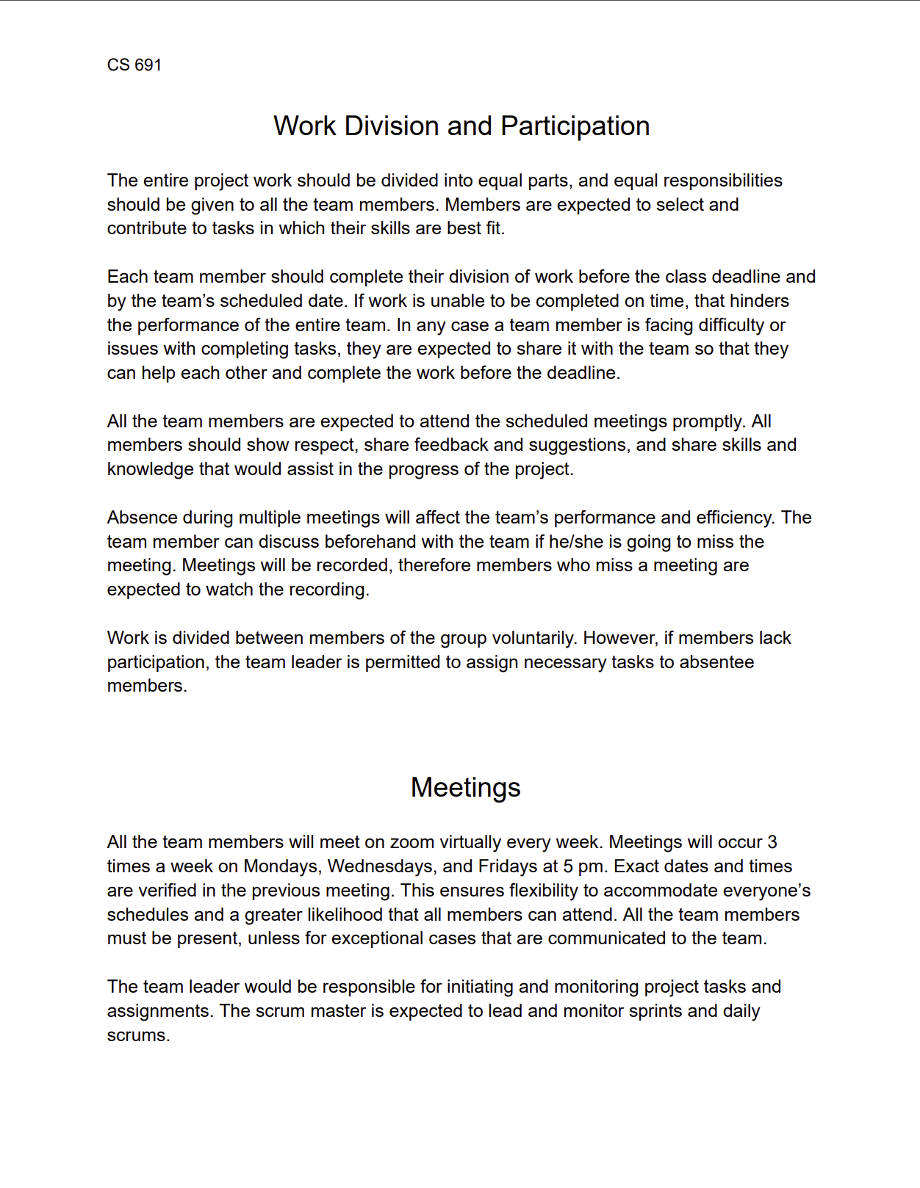
Team Working Agreement

Slide 17
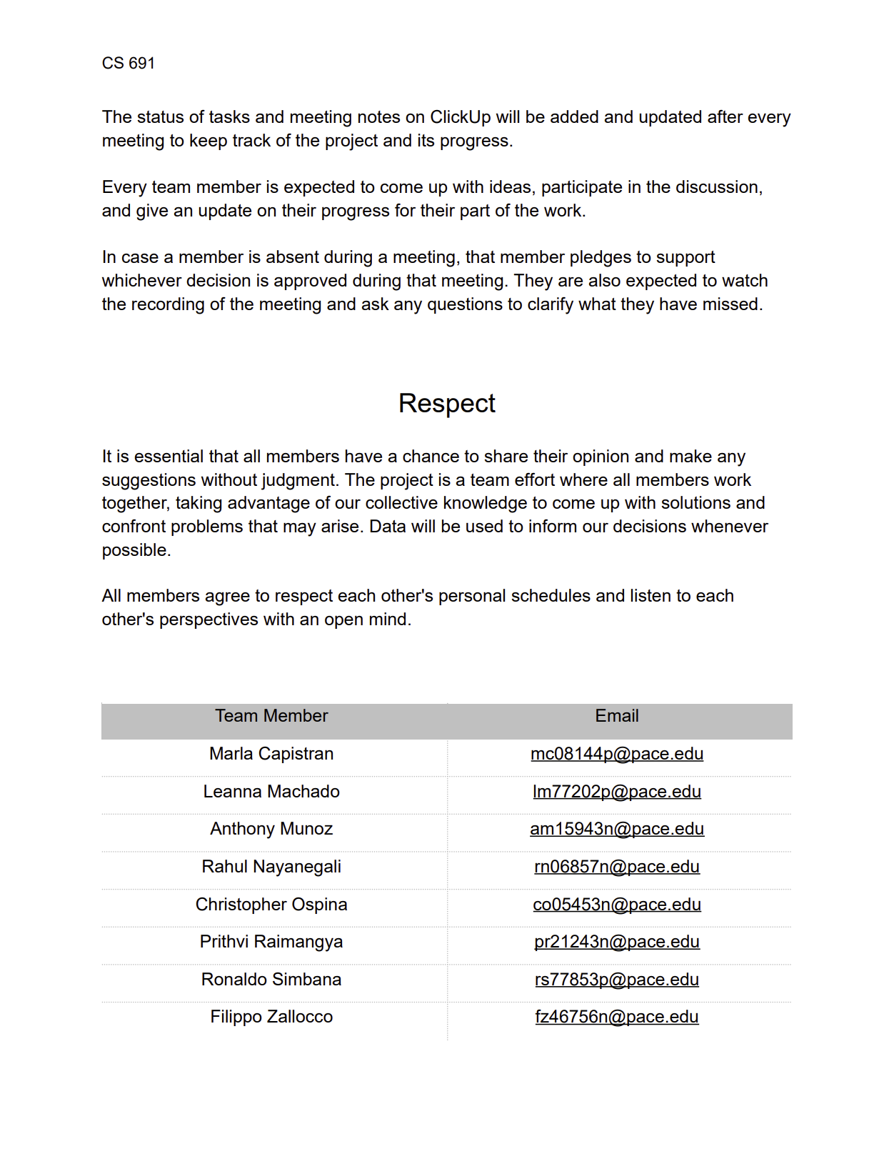
Team Working Agreement

Slide 18

Patient Persona
Harold Castillo
Age: 55
Gender: Male
Occupation: Restaurant Owner
Location: Red Bank, NJ
Harold gets regular check-ups for a man his age but has trouble scheduling due to his job. It’d be great if he could just view his results and get an idea of what they mean and potential next steps without having to keep going in person.
Goals
View reports/results online
Able to connect with doctor about results online
Simple site for ease of use
Challenges
Making it to follow-ups for results
Understanding the results, even after a consultation
Time taken to receive results

Slide 19

Radiologist Persona
Sandro Cuccigno
Age: 50
Gender: Male
Occupation: Radiologist
Location: Manhattan, NY
Hospital: NYU Langone Medical Center
Has been in the practice for 20 years. His team is understaffed and under equipped. Is often exhausted from reviewing x-rays and informing people they have a serious illness.
Goals
Process chest images fast
Help hospital tend to patients
Improve workflow for his team
Challenges
Increasing patient volumes
Burnout from long shift and nature of the job
Facility cutting funds
Spends many hours reviewing x-rays

Slide 20

Doctor Persona
Dr. Bryce Ruiz
Age: 34
Gender: Male
Occupation: Doctor
Location: Fresno, Ca
Hospital: Albuquerque Medical Center
A 34-year-old medical professional from Fresno. Has been working at Albuquerque for over 10 years and has recently been promoted to Cardiology to conduct x-rays
Goals
Build a strong reputation with patients
Explain to patients what they have in a clear manner
Challenges
Large volume of patients
Limited time for consultations
Patients are often confused about their diagnosis

Slide 21
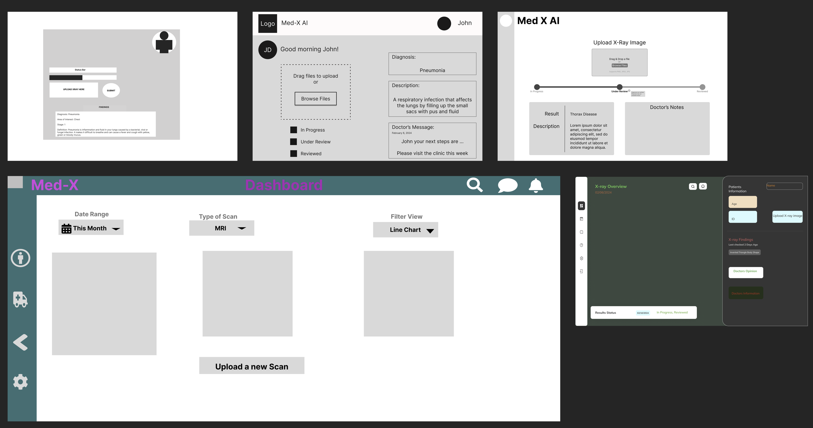
Product Discovery

Slide 22
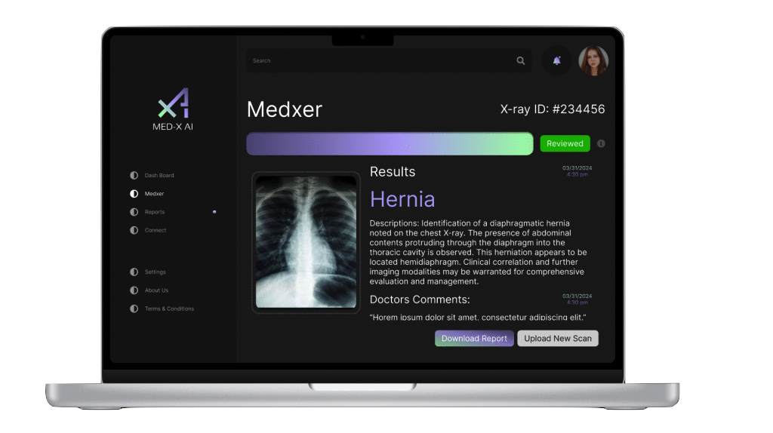
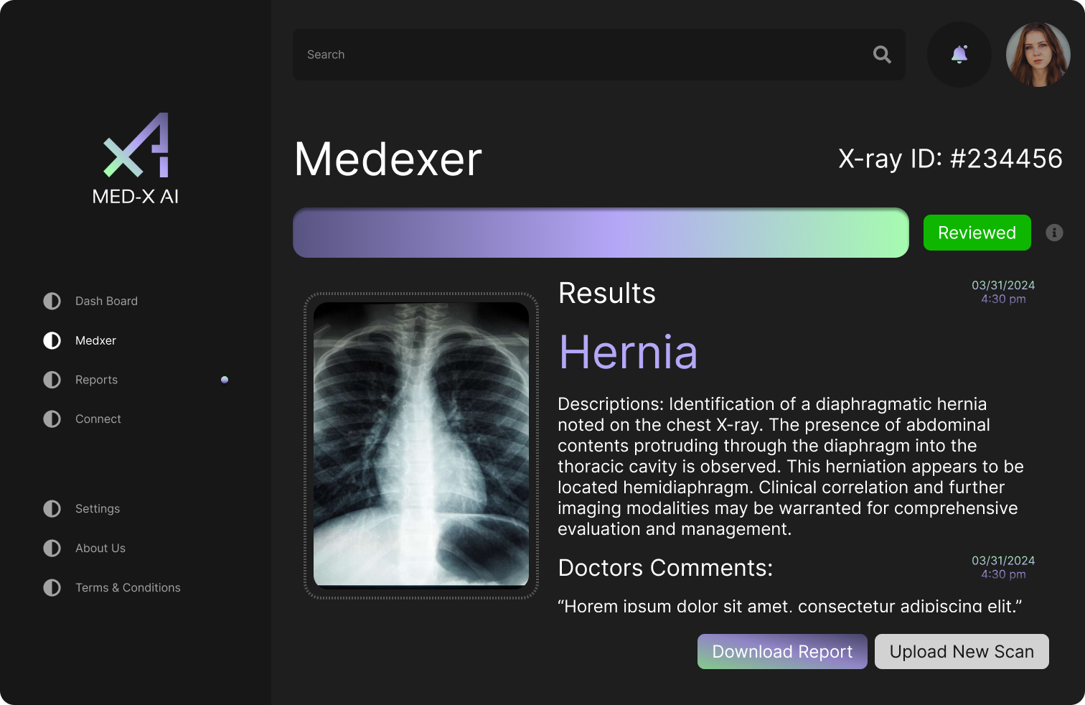
Final Product Design

Slide 23
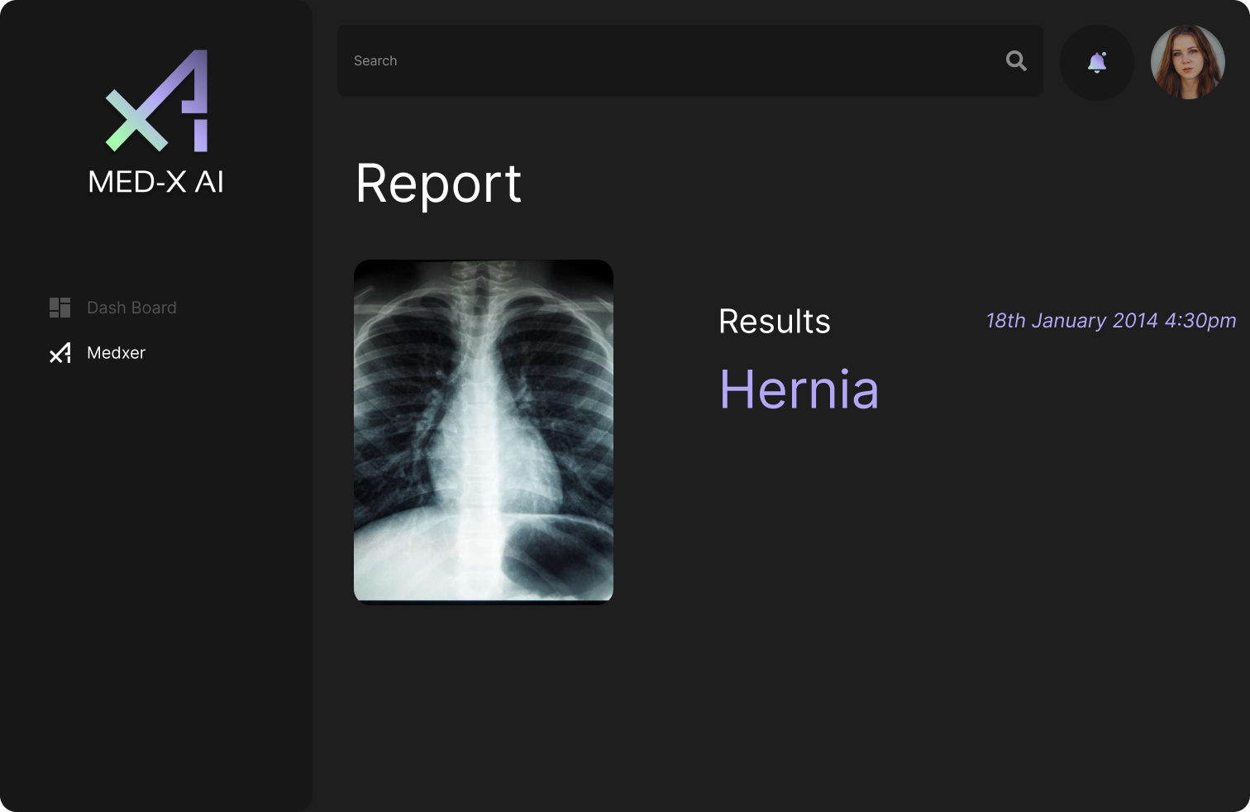
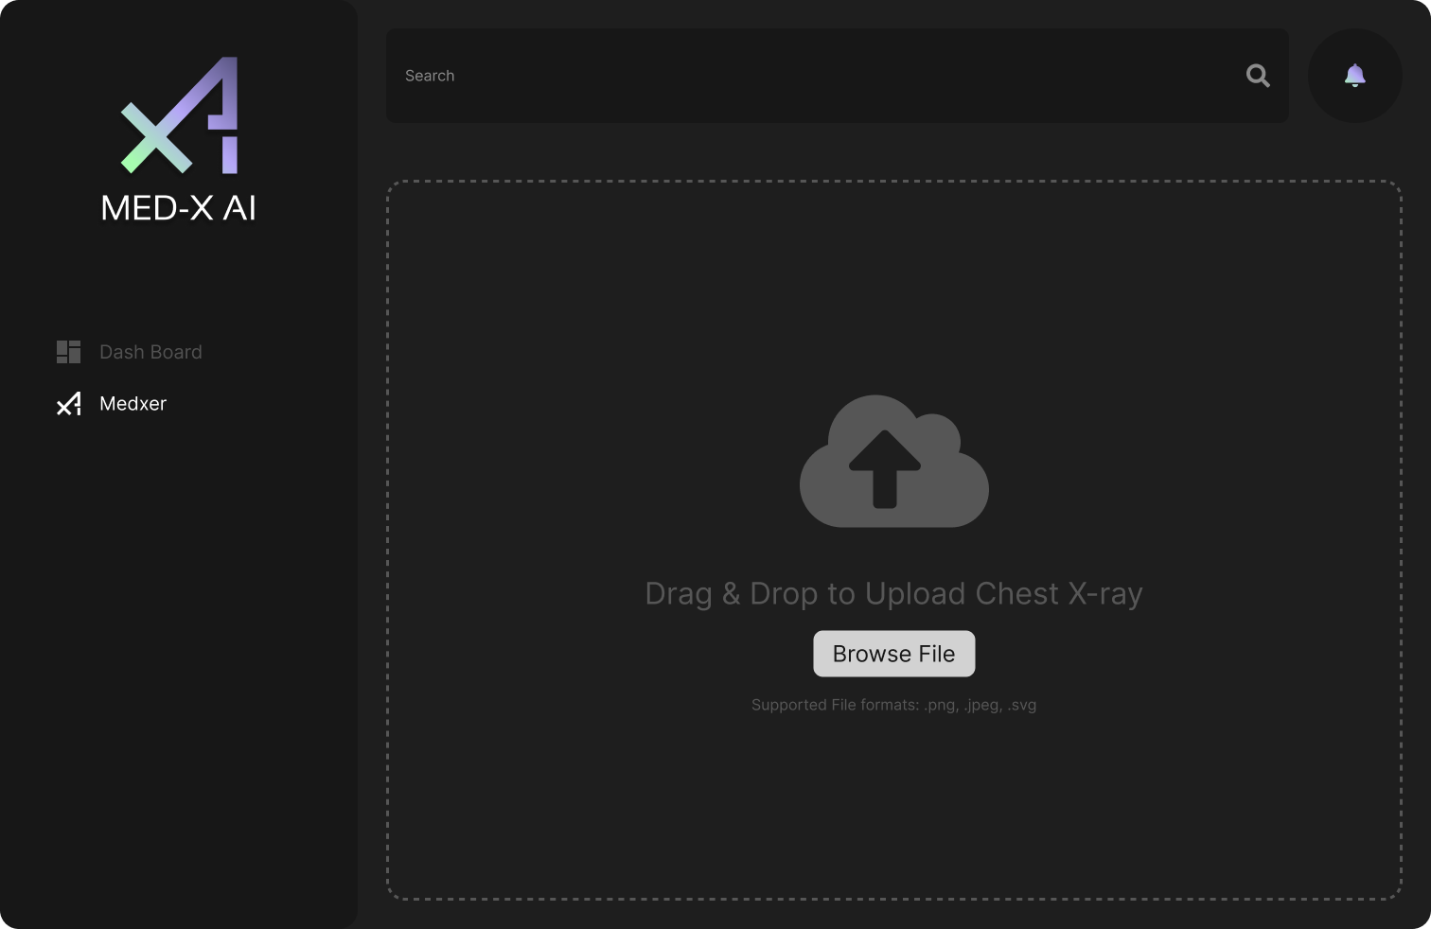
MVP Design

Slide 24

















Technologies & Algorithms
Programming Languages
and Frameworks
Algorithms
Database
Tools
TensorFlow
CNN
Firebase
Figma
VSCode
HTML5
CSS
JavaScript
Keras
Docker
GitHub
React
NodeJS
Flask
Insomnia
Python
Tailwind CSS

Slide 25
Technologies & Algorithms
Programming Languages
and Frameworks
Algorithms
Database
Tools
TensorFlow
CNN
Firebase
Figma
VSCode
HTML5
CSS
JavaScript
Keras
Docker
GitHub
React
NodeJS
Flask
Insomnia
Python
Tailwind CSS

Slide 26
Technologies & Algorithms
Programming Languages
and Frameworks
Algorithms
Database
Tools
Firebase
Figma
VSCode
TensorFlow
CNN
HTML5
CSS
JavaScript
Docker
GitHub
React
NodeJS
Flask
Keras
Insomnia
Python
Tailwind CSS

Slide 27
Technologies & Algorithms
Programming Languages
and Frameworks
Algorithms
Database
Tools
TensorFlow
CNN
Figma
VSCode
Firebase
HTML5
CSS
JavaScript
Keras
Docker
GitHub
React
NodeJS
Flask
Insomnia
Python
Tailwind CSS

Slide 28

Technologies & Algorithms
Programming Languages
and Frameworks
Algorithms
Database
Tools
TensorFlow
CNN
Firebase
Figma
VSCode
HTML5
CSS
JavaScript
Keras
Docker
GitHub
React
NodeJS
Flask
Python
Tailwind CSS
Insomnia

Slide 29
Technologies Explanation
HTML5
CSS
JavaScript
Flask
Python
Firebase
React
NodeJS
Tailwind CSS
MedX app leverages HTML, CSS, JavaScript, React, Node and Tailwind CSS for the dynamic user interface
Python's micro framework Flask is used to render the chest x-ray findings on the user interface by calling the trained model
Firebase is used to store the uploaded image and provides an endpoint URL to call the API

Slide 30
Technologies Explanation
Figma
VSCode
Insomnia
Docker
GitHub
Figma, VSCode, and GitHub are tools used for efficient collaboration. Figma enables a seamless contribution for the overall development. VSCode is the chosen code editor. GitHub allows remote version control and collaborative development. Docker simplifies deployment across all platforms. Insomnia is a tool used to test the APIs.

Slide 31
Algorithms Explanation
TensorFlow's Keras API is used for building and training our Convolutional Neural Network, which classifies x-ray images for diagnosis. The deep learning model integrates different layers.
Convolutional Layers
Batch Normalization
Dropout
Regularization
We optimized training with the Adam algorithm
TensorFlow
Keras
CNN

Slide 32
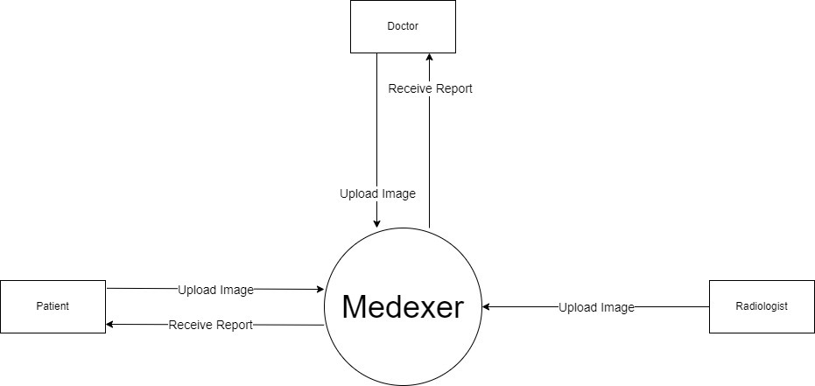
Context Diagram

Slide 33
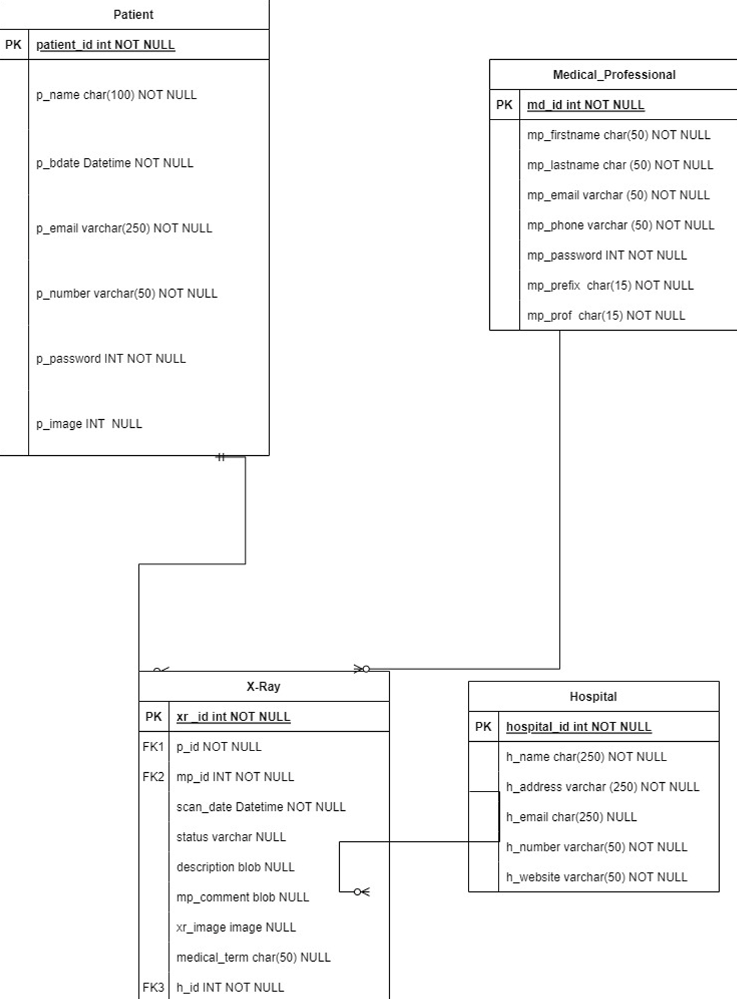
Class Diagram

Slide 34
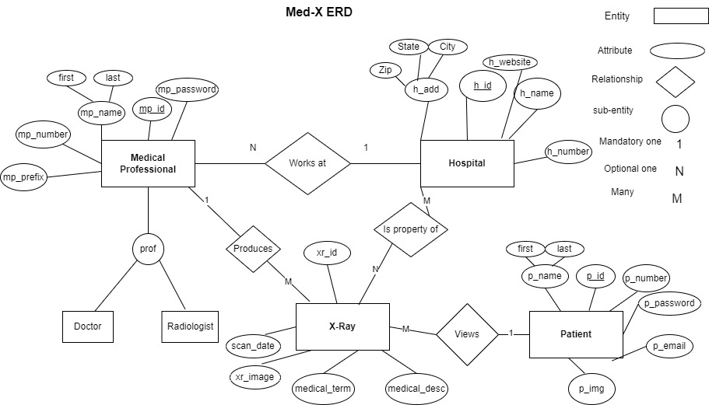
ER Diagram

Slide 35
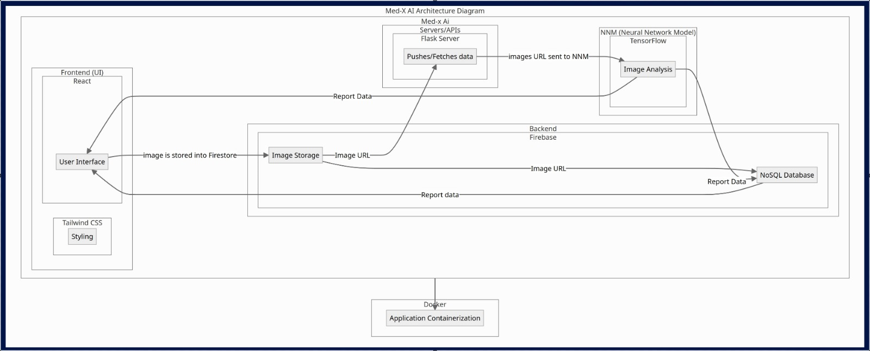
Architecture Diagram

Slide 36
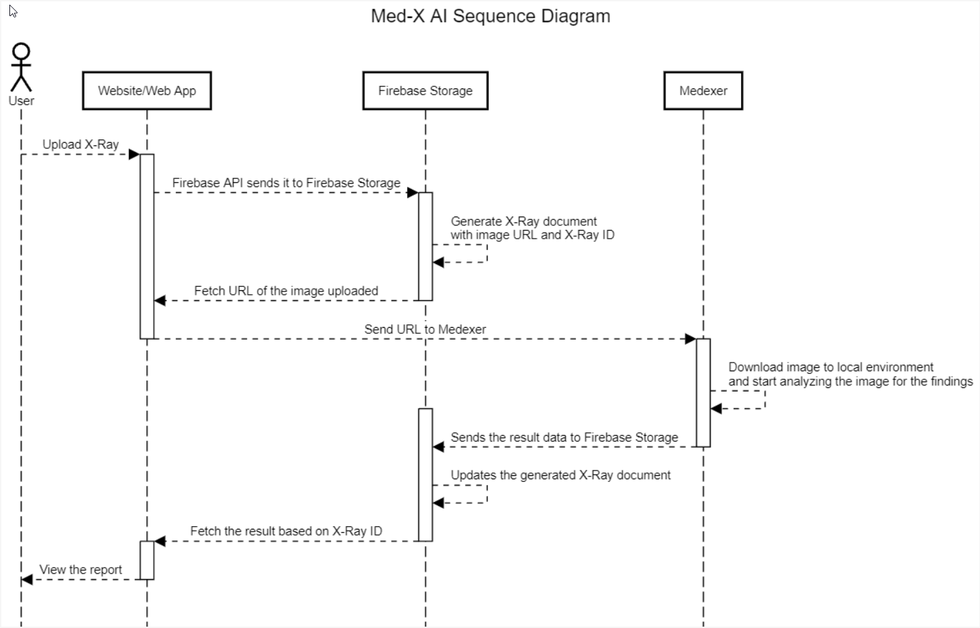
Sequence Diagram

Slide 37
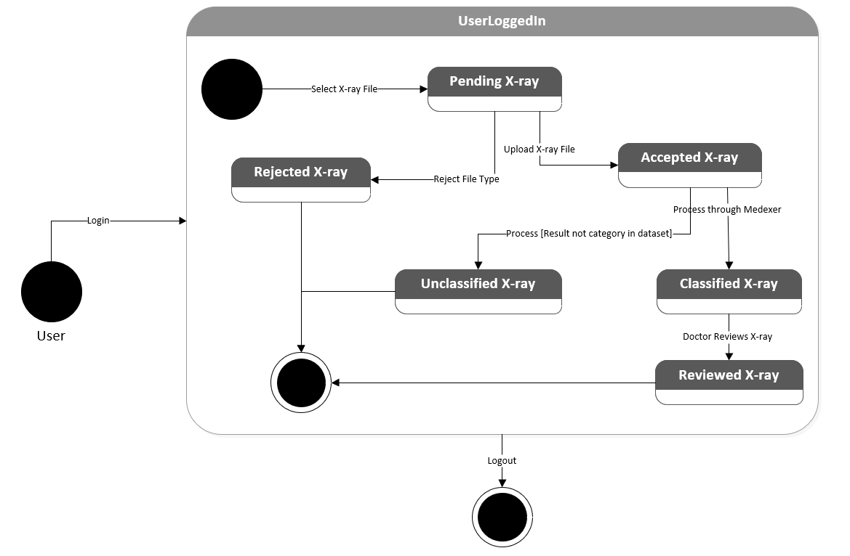
State Diagram

Slide 38
User Stories / Story Points
Estimation | User ID | As a | I want | So that | Feature
3 | 1 | Radiologist | to easily upload x-ray images | doctors and patients have access to the images | Image Upload
3 | 2 | Doctor | to easily upload x-ray images | doctors and patients have access to the images | Image Upload
3 | 3 | Patient | to easily upload x-ray images from my personal machine | doctors have access to the images for review | Image Upload
13 | 4 | Radiologist | to provide quick and automated x-ray results for common chest health issues | more time can be dedicated to analyze uncommon chest health issues | Medexer (AI)
13 | 5 | Doctor | to provide quick and automated x-ray results for common chest health issues | patient response rate and physician workflow improves | Medexer (AI)
8 | 6 | Doctor | to add comments to patient x-ray results | patients are informed early about other information the result does not provide | Doctor Notes
5 | 7 | Patient | to view whether a doctor has reviewed my x-ray results | I can be more confident about the verified results | Reviewed Status
Legend:
Sprint 2
Sprint 3
Sprint 4

Slide 39
User Stories / Story Points
Estimation | User ID | As a | I want | So that | Feature
2 | 8 | Patient | my x-ray results to be explained in simpler terms | I can better understand my diagnosis and health issue | Result Description
1 | 9 | Doctor | to download patient x-ray reports | I can store patient records locally | Download Report
1 | 10 | Patient | to download my x-ray reports | I can store patient records locally | Download Report
5 | 11 | Patient | to have access to all of my x-ray report history | I can track my chest health issues | Report History
5 | 12 | Doctor | to have access to all patient x-ray report histories | I can track patient chest health issues | Report History
2 | 13 | Patient | to quickly view my latest x-ray report | my most recent information is easily accessible | Dashboard
5 | 14 | Patient | to be notified once there is a change to my reports (upload, review, notes, etc.) | I can be informed about any updates as soon as possible | Notification
Legend:
Sprint 2
Sprint 3
Sprint 4

Slide 40
User Stories / Story Points
Estimation | User ID | As a | I want | So that | Feature
5 | 15 | Doctor | to be notified once there is a change to patient reports (upload, report, etc.) | I can be informed about any updates as soon as possible | Notification
8 | 16 | Doctor | to browse a specific report and record | I can quickly locate specified information | Search
8 | 17 | Patient | to browse a specific report and record | I can quickly locate specified information | Search
3 | 18 | Radiologist | to register and store my personal info (ID, name, D.O.B.) in my own account | I can access patient information and connect with patients and doctors privately | Profile
3 | 19 | Doctor | to register and store my personal info (ID, name, D.O.B.) in my own account | I can access patient information and connect with patient and radiologists privately | Profile
Legend:
Sprint 2
Sprint 3
Sprint 4

Slide 41
User Stories / Story Points
Estimation | User ID | As a | I want | So that | Feature
3 | 20 | Patient | to register and store my personal info (ID, name, D.O.B.) in my own account | I can access my medical information and connect with doctors privately | Profile
3 | 21 | Patient | to login and logout of my own account | my medical information, records and reports are secure | Login/Logout
3 | 22 | Doctor | to login and logout of my own account | Patient medical information, records and reports are secure | Login/Logout
3 | 23 | Patient | to login using my e-mail address | I can access my medical information, records and reports | Login/Logout
3 | 24 | Doctor | to login using my medical professional ID number | I can access patient medical information, records and reports | Login/Logout
1 | 25 | Patient | update my personal information such as my name, address, phone number etc. | the portal has up-to-date information in the event I need to be reached urgently | Profile
Legend:
Sprint 2
Sprint 3
Sprint 4

Slide 42
User Stories / Acceptance Criteria
User ID | Scenario | Summary | Criteria | Feature
1 | As a Radiologist I want to easily upload x-ray images so that doctors and patients have access to the images
 | A radiologist wants to upload an x-ray image | Given I'm a radiologist when I open the Med-X AI web app I should be able to locate an upload button that when clicked on and an image is selected then the application will store the image for processing | Med-X AI App will store the image for processing | Image Upload
2 | As a Doctor I want to easily upload x-ray images so that doctors and patients have access to the images
 | A doctor wants to upload an x-ray image | Given I'm a doctor when I open the Med-X AI web app I should be able to locate an upload button that when clicked on and an image is selected then the application will store the image for processing | Med-X AI App will store the image for processing | Image Upload
3 | As a Patient I want to easily upload x-ray images from my personal machine so that doctors have access to the images for review
 | A patient wants to upload an x-ray image | Given I'm a patient when I open the Med-X AI web app I should be able to locate an upload button that when clicked on and an image is selected then the application will store the image for processing | Med-X AI App will store the image for processing | Image Upload
Legend:
Sprint 2
Sprint 3
Sprint 4

Slide 43
User Stories / Acceptance Criteria
User ID | Scenario | Summary | Criteria | Feature
4 | As a Radiologist I want to provide quick and automated x-ray results for common chest health issues so that more time can be dedicated to analyze uncommon chest health issues
 | A radiologist wants to quickly provide an x-ray result | Given I'm a radiologist when I upload an x-ray image then the application will provide a quick diagnosis | Med-X AI App will provide a diagnosis (finding) for the chest health issue | Medexer (AI)
5 | As a Doctor I want provide quick and automated x-ray results for common chest health issues so that patient response rate and physician workflow improves
 | A doctor wants to quickly access patient x-ray results | Given I'm a doctor when an x-ray image produces quick results I can then access the result in order to provide patients with a verified response | Med-X AI App will provide a diagnosis (finding) for the chest health issue | Medexer (AI)
6 | As a Doctor I want to add comments to patient results so that patients are informed early about other information the result does not provide
 | A doctor wants to write a comment to patient about the x-ray result | Given I'm a doctor when I click on the Doctor's Comments section on a patient's report I can then type and post a message that the patient can see | Med-X AI App will provide a text message section for each report to allow doctors to post | Doctor Notes
Legend:
Sprint 2
Sprint 3
Sprint 4

Slide 44
User Stories / Acceptance Criteria
User ID | Scenario | Summary | Criteria | Feature
7 | As a Patient I want to view whether a doctor has reviewed my x-ray results so that I can be more confident about the verified results
 | A patient wants to see any additional comments from the doctor | Given I'm a patient when I click on a report in Reports, I can then view a status bar reporting if a doctor has verified the x-ray result | Med-X App will allow patients to view "Under Review" or "Reviewed" status bar in reports | Reviewed Status
8 | As a Patient I want my x-ray results to be explained in simpler terms so that I can better understand my diagnosis and health
 | A patient wants to better understand their x-ray result | Given I'm a patient when I click on a report in Reports tab, I can then view a text description of the result in plain language so I can better understand the technical result | Med-X AI App will provide a text description of the finding in the selected report | Result Description
9 | As a Doctor I want to download patient x-ray reports so that I can store patient records locally
 | A Doctor wants to store patient records locally | Given I'm a doctor when I open a patient's report and click a download button the selected record is then downloaded and saved to my local computer | Med-X AI App will transfer the report file from the remote system to the user's local system | Download Report
Legend:
Sprint 2
Sprint 3
Sprint 4

Slide 45
User Stories / Acceptance Criteria
User ID | Scenario | Summary | Criteria | Feature
10 | As a Patient I want to download my x-ray reports so that I can store my records locally
 | A patient wants to store medical records locally | Given I'm a patient when I open my report and click a download button the selected report is then downloaded and saved to my local computer | Med-X AI App will transfer the report file from the remote system to the user's local system | Download Report
11 | As a Patient I want to have access to my x-ray report history so that I can track my chest health issues
 | A patient wants to keep track of all of their x-ray reports | Given I'm a patient when I click on the Reports tab then I should see a gallery of reports that have been generated | Med-X AI App will store all the reports in the cloud | Report History
12 | As a Doctor I want to have access to patient x-ray report histories so that I can track patient chest health issues
 | A doctor wants to keep track of their patients reports | Given I'm a doctor when I click on the Reports tab of a specific patient then I should see a gallery of reports that has been generated for that patient | Med-X AI App will store all the reports in the cloud | Report History
Legend:
Sprint 2
Sprint 3
Sprint 4

Slide 46
User Stories / Acceptance Criteria
User ID | Scenario | Summary | Criteria | Feature
13 | As a Patient I want to quickly view my latest x-ray report so that my most recent information is easily accessible
 | A patient wants to view their latest x-ray report | Given I'm a patient when I log into the account then the Dashboard page will be displayed with the most recent x-ray results | Med-X AI App will open to the Dashboard upon sign in | Dashboard
14 | As a Patient I want to be notified once there is a change to my reports (upload, review, notes, etc.) so that I can be informed about any updates as soon as possible
 | A patients wants to be informed of any changes to their reports | Given I'm a patient when a change is made to my report then I should receive a notification | Med-X AI App will alert the user of a change made to their report | Notification
15 | As a Doctor I want to be notified once there is a change to patient reports (upload, report, etc.) so that I can be informed about any updates as soon as possible
 | A doctor wants to be informed of any changes to patient reports | Given I'm a doctor when a change is made to a patient report then I should receive a notification | Med-X AI App will alert the user of a change made to their report | Notification
Legend:
Sprint 2
Sprint 3
Sprint 4

Slide 47
User Stories / Acceptance Criteria
User ID | Scenario | Summary | Criteria | Feature
16 | As a Doctor I want to browse all reports and records so that I can quickly locate specified information
 | A doctor wants to locate a specific report/record | Given I'm a doctor when I search for a report in the search bar then I should be able to quickly locate it | Med-X AI App will store reports using an x-ray id and patient name | Search
17 | As a Patient I want to browse my reports and records so that I can quickly locate specified information
 | A patient wants to locate a specific report/record | Given I'm a patient when I search for a report in the search bar then I should be able to quickly locate it | Med-X AI App will store reports using an x-ray id | Search
18 | As a Radiologist I want to register and store my personal info (ID, name, DOB) in my own account so that I can access patient information and connect to patients and doctors privately
 | A radiologist wants to create their own account to securely access patient information | Given I'm a radiologist when I use the app, I should be able to have my own account then patient information will be secured, and communication will be private | Med-X AI App will store user credentials (medx ID) | Profile
Legend:
Sprint 2
Sprint 3
Sprint 4

Slide 48
User Stories / Acceptance Criteria
User ID | Scenario | Summary | Criteria | Feature
19 | As a Doctor I want to register and store my personal info (ID, name, DOB) in my own account so that I can access patient information and connect to patients and radiologists privately
 | A doctor wants to create their own account to securely access patient information | Given I'm a doctor when I use the app, I should be able to have my own account then patient information will be secured, and communication will be private | Med-X AI App will store user credentials (medx ID) | Profile
20 | As a Patient I want to register and store my personal info (ID, name, DOB) in my own account so that I can access my medical information and connect to doctors privately
 | A patient wants to create their own account to securely access their information | Given I'm a patient when I use the app, I should be able to have my own account then my information will be secured, and communication will be private | Med-X AI App will store email and password | Profile
Legend:
Sprint 2
Sprint 3
Sprint 4

Slide 49
User Stories / Acceptance Criteria
User ID | Scenario | Summary | Criteria | Feature
21 | As a Patient I want to login and logout of my own account so that my medical information, records and reports are secure
 | A patient wants to securely and privately start and end sessions on their account | Given I'm a patient when I open the app, I then am prompted to log in to my account with my credentials and click a logout button to end my session | Med-X AI App will begin with a login page and have a button to logout of the current account | Login/Logout
22 | As a Doctor I want to login and logout of my own account so that patient medical information, records and reports are secure
 | A doctor wants to securely and privately start and end sessions on their account | Given I'm a doctor when I open the app, I then am prompted to log in to my account with my credentials and click a logout button to end my session | Med-X AI App will begin with a login page and have a button to logout of the current account | Login/Logout
Legend:
Sprint 2
Sprint 3
Sprint 4

Slide 50
User Stories / Acceptance Criteria
User ID | Scenario | Summary | Criteria | Feature
23 | As a Patient I want to login using my e-mail address so that I can access my medical information, records and reports
 | A patient wants to access their medical records by using their personal e-mail address | Given I'm a patient when I am prompted to login, I can then enter my personal e-mail address to access the records related to my account | Med-X AI App will create and store patient accounts through e-mail (username) | Login/Logout
24 | As a Doctor I want to login using my medical professional ID number so that I can access patient medical information, records and reports
 | A doctor wants to access patient medical records by using their ID number | Given I'm a doctor when I am prompted to login, I can then enter my personal medx ID number to access the records related to my account | Med-X AI App will create and store doctor accounts through their ID number (username) | Login/Logout
Legend:
Sprint 2
Sprint 3
Sprint 4

Slide 51
User Stories / Acceptance Criteria
User ID | Scenario | Summary | Criteria | Feature
25 | As a Patient I want to update my personal information such as my name, address, phone number, etc. so that the portal has up-to-date information in the event I need to be reached urgently
 | A patient wants to update personal profile information when they change | Given I'm a patient when I click my profile and the edit button, I can then change the inputted profile information (name, address, phone number, etc.) and click save | Med-X AI App will allow patients to update profile information and store the changes in the database | Profile
Legend:
Sprint 2
Sprint 3
Sprint 4

Slide 52
Test Cases
User ID | Feature to Test | Test Case | Test Steps | Test Data | Expected Result | Actual Result | Pass/ Fail | Comments
1 & 2 | Image Upload | Verify accepted image file type (Medexer) | Click Medexer tab -> Click Browse button -> Select PNG/JPG image file | PNG/ JPG file | Selected PNG file uploaded and image is presented to upload | Image is uploaded to the Medexer tool | Pass | PNG Image file accepted
1 & 2 | Image Upload | Verify accepted image file type (Medexer) | Click Medexer tab -> Click Browse button -> Select PDF file | PDF file | Error message is displayed | Unsupported file format. Please upload a .png or .jpeg file | Pass | PDF Image is unsupported
 | Firebase | Successful Image Upload | Click Medexer tab -> Click Browse button -> Select PNG/JPG image file -> Alert Message -> Firebase Storage | PNG/ JPG file | Image uploaded is stored in Firebase | Image uploaded | Pass | Image is available in the cloud

Slide 53
Test Cases
User ID | Feature to Test | Test Case | Test Steps | Test Data | Expected Result | Actual Result | Pass/ Fail | Comments
4 & 5 | Findings | Passing a non-x-ray image to Med-X NNM | Click Medexer tab -> Click Browse button -> Select file that is not PNG/JPG image -> Click Submit | PNG/ JPG file | Error Message "Make sure you have uploaded a chest x-ray image" | No finding | Fail | Error message is not displayed
4 & 5 | Findings | passing an x-ray image with no known disease to Med-X NNM | Click Medexer tab -> Click Browse button -> Select a PNG/JPG image -> Click Submit | PNG/ JPG file | No Finding | No Finding | Pass | Insufficient data NNM may not be accurate
4 & 5 | Findings | Passing an x-ray image with a disease to Med-X NNM | Click Medexer tab -> Click Browse button -> Select a PNG/JPG image -> Click Submit | PNG/ JPG file | A Finding | Aortic Enlargement | Pass | Medical term of disease was provided Insufficient data NNM may not be accurate

Slide 54
Sprint 2 Stories:
Estimation | User ID | As a | I want | So that | Feature
3 | 1 | Radiologist | to easily upload x-ray images | doctors and patients have access to the images | Image Upload
3 | 2 | Doctor | to easily upload x-ray images | doctors and patients have access to the images | Image Upload
3 | 3 | Patient | to easily upload x-ray images from my personal machine | doctors have access to the images for review | Image Upload
13 | 4 | Radiologist | to provide quick and automated x-ray results for common chest health issues | more time can be dedicated to analyze uncommon chest health issues | Medxer (AI)
13 | 5 | Doctor | quick access to patient x-ray results for common chest health issues | patient response rate and physician workflow improves | Medxer (AI)
Sprint 2 Story Points: 35

Slide 55
Sprint 2 Story Completion
Estimation | User ID | As a | I want | So that | Feature | Status
3 | 1 | Radiologist | to easily upload x-ray images | doctors and patients have access to the images | Image Upload | Completed
3 | 2 | Doctor | to easily upload x-ray images | doctors and patients have access to the images | Image Upload | Completed
3 | 3 | Patient | to easily upload x-ray images from my personal machine | doctors have access to the images for review | Image Upload | Completed
13 | 4 | Radiologist | to provide quick and automated x-ray results for common chest health issues | more time can be dedicated to analyze uncommon chest health issues | Medxer (AI) | Completed
13 | 5 | Doctor | quick access to patient x-ray results for common chest health issues | patient response rate and physician workflow improves | Medxer (AI) | Completed

Slide 56
Team Velocity
35 story points

Slide 57
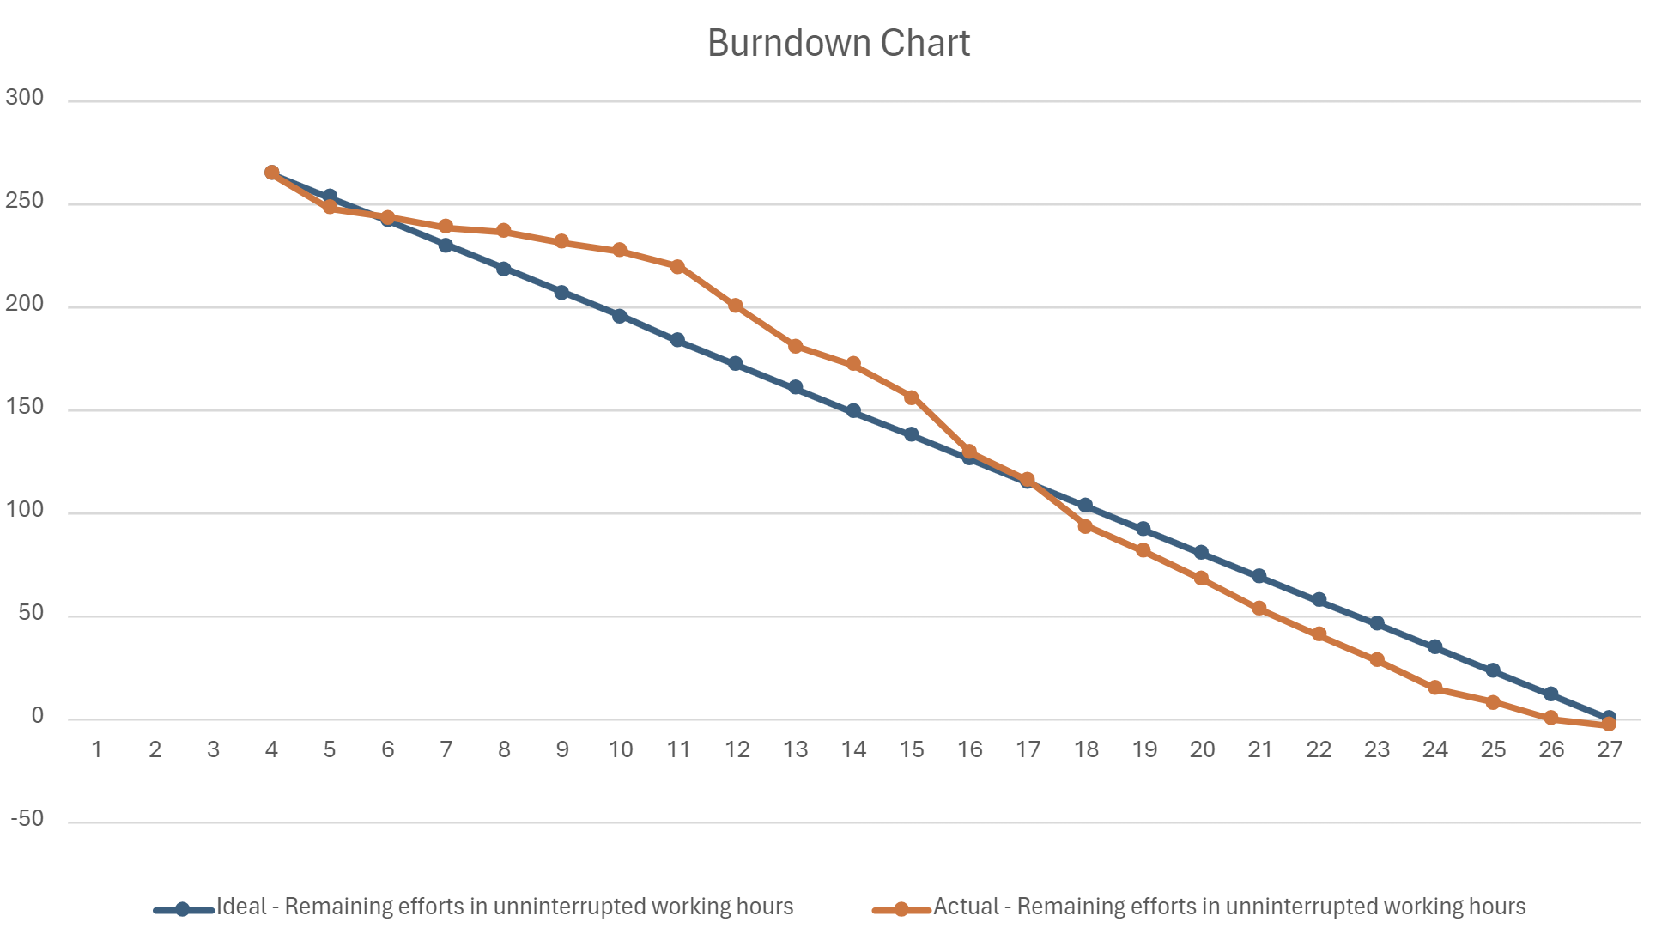
Burndown Chart

Slide 58
Completed / Committed Ratio
35/35
100%
Sprint 2 Story Points: 35

Slide 59
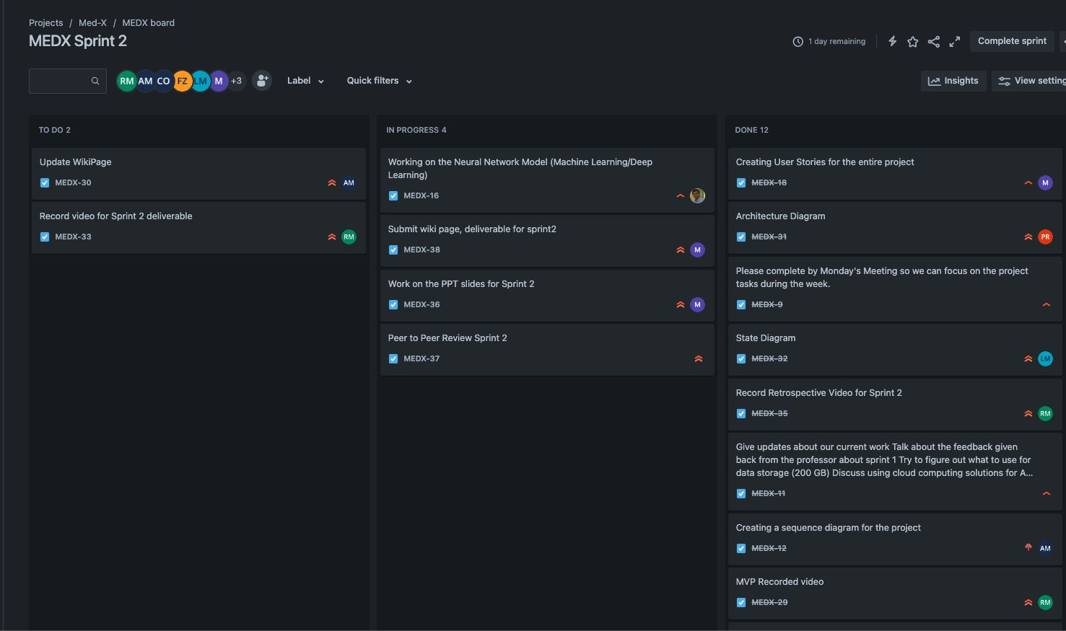
Project Schedule

Slide 60
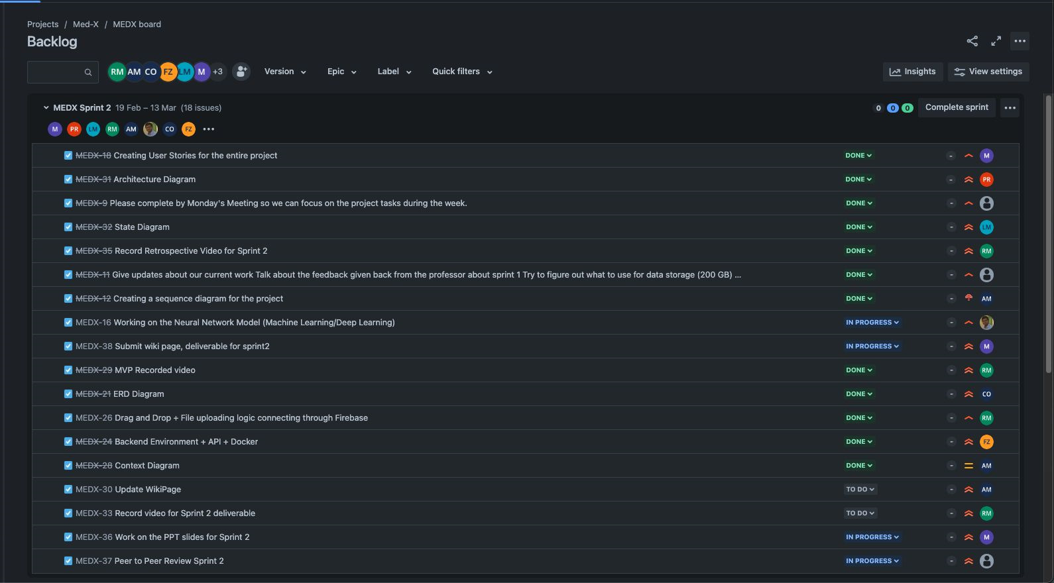
Project Backlog

Slide 61
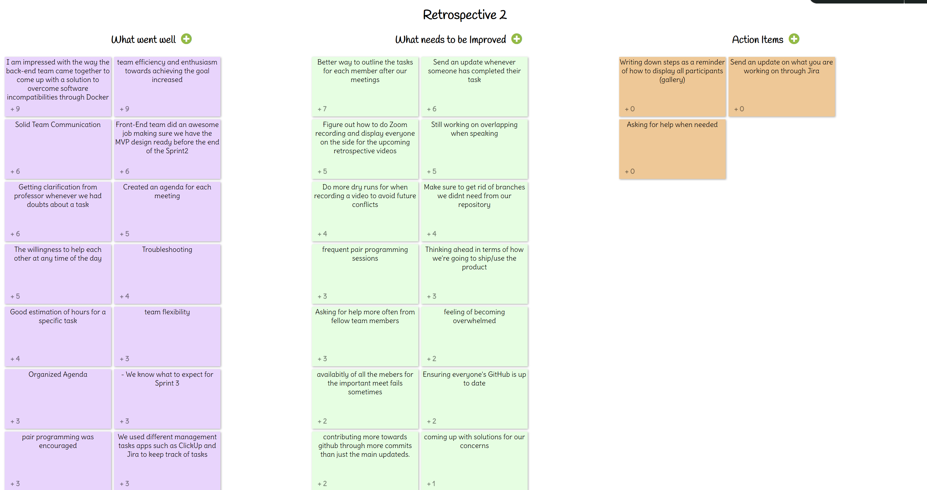
Retrospective:

Slide 62
Retrospective:
What Went
Well
What needs to be Improved
Action
Items
Coming up with a solution to overcome software incompatibility
Team efficiency and enthusiasm towards achieving the goal
Getting clarification when there were doubts
Outlining tasks for each team member
Sending an update whenever someone is done with their task
Figuring out how to do Zoom recordings so everyone is displayed (gallery view)
Writing down steps of how to display all participants on the screen
Send an update on Jira
Asking for help when needed

Slide 63
Retrospective:
What Went
Well
What needs to be Improved
Action
Items
Coming up with a solution to overcome software incompatibility
Team efficiency and enthusiasm towards achieving the goal
Getting clarification when there are doubts
Outlining tasks for each team member
Sending an update whenever someone is done with their task
Figuring out how to do Zoom recordings so everyone is displayed (gallery view)
Writing down steps of how to display all participants on the screen
Send an update on Jira
Asking for help when needed

Slide 64
Retrospective:
What Went
Well
What needs to be Improved
Action
Items
Coming up with a solution to overcome software incompatibility
Team efficiency and enthusiasm towards achieving the goal
Getting clarification when there are doubts
Outlining tasks for each team member
Sending an update whenever someone is done with their task
Figuring out how to do Zoom recordings so everyone is displayed (gallery view)
Writing down steps of how to display all participants on the screen
Send an update on Jira
Asking for help when needed

Slide 65
Retrospective:
What Went
Well
What needs to be Improved
Action
Items
Coming up with a solution to overcome software incompatibility
Team efficiency and enthusiasm towards achieving the goal
Getting clarification when there are doubts
Outlining tasks for each team member
Sending an update whenever someone is done with their task
Figuring out how to do Zoom recordings so everyone is displayed (gallery view)
Writing down steps of how to display all participants on the screen
Send an update on Jira
Asking for help when needed

Slide 66
Sprint 3 Stories:
Estimation | User ID | As a | I want | So that | Feature
8 | 6 | Doctor | to add comments to patient x-ray results | patients are informed early about other information the result does not provide | Doctor Notes
5 | 7 | Patient | to view whether a doctor has reviewed my x-ray results | I can be more confident about the verified results | Reviewed Status
1 | 9 | Doctor | to download patient x-ray reports | I can store patient records locally | Download Report
1 | 10 | Patient | to download my x-ray reports | I can store patient records locally | Download Report
2 | 13 | Patient | to quickly view my latest x-ray report | my most recent information is easily accessible | Dashboard
8 | 16 | Doctor | to browse a specific report and record | I can quickly locate specified information | Search
8 | 17 | Patient | to browse a specific report and record | I can quickly locate specified information | Search
Sprint 3 Story Points: 33

Slide 67
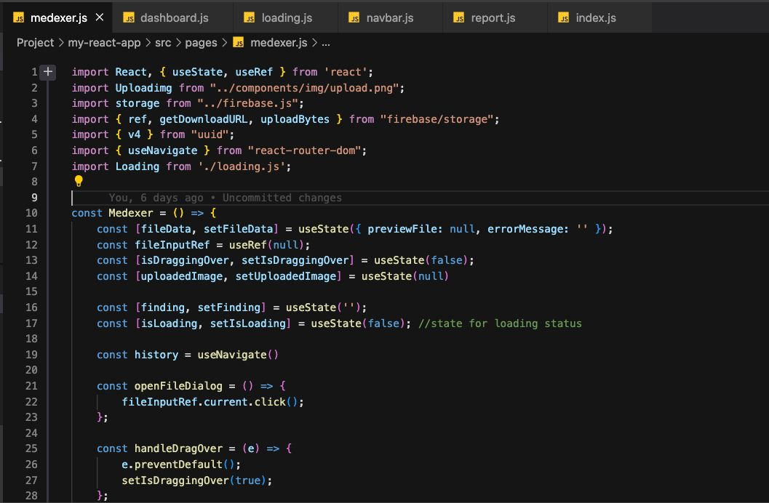
Code Snippet:

Slide 68
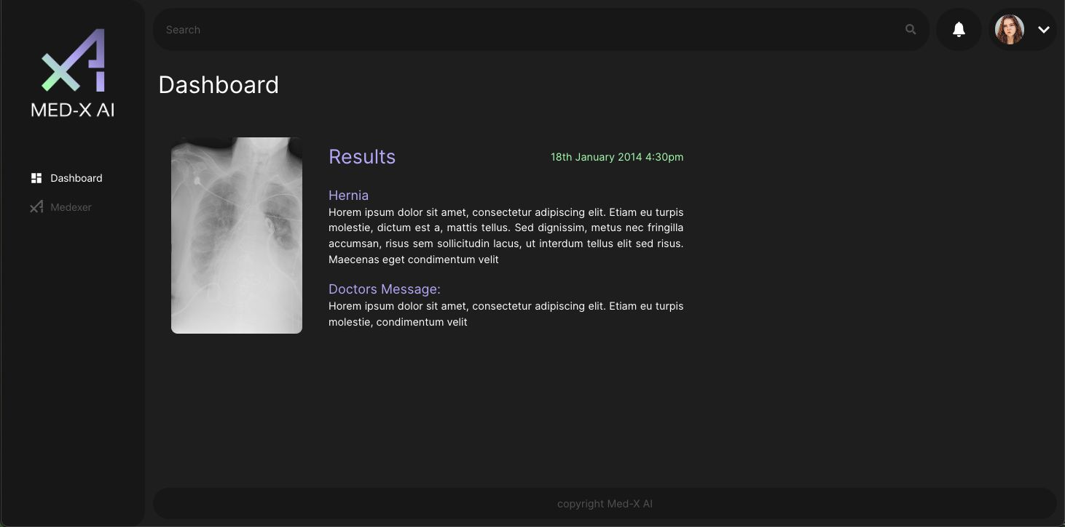
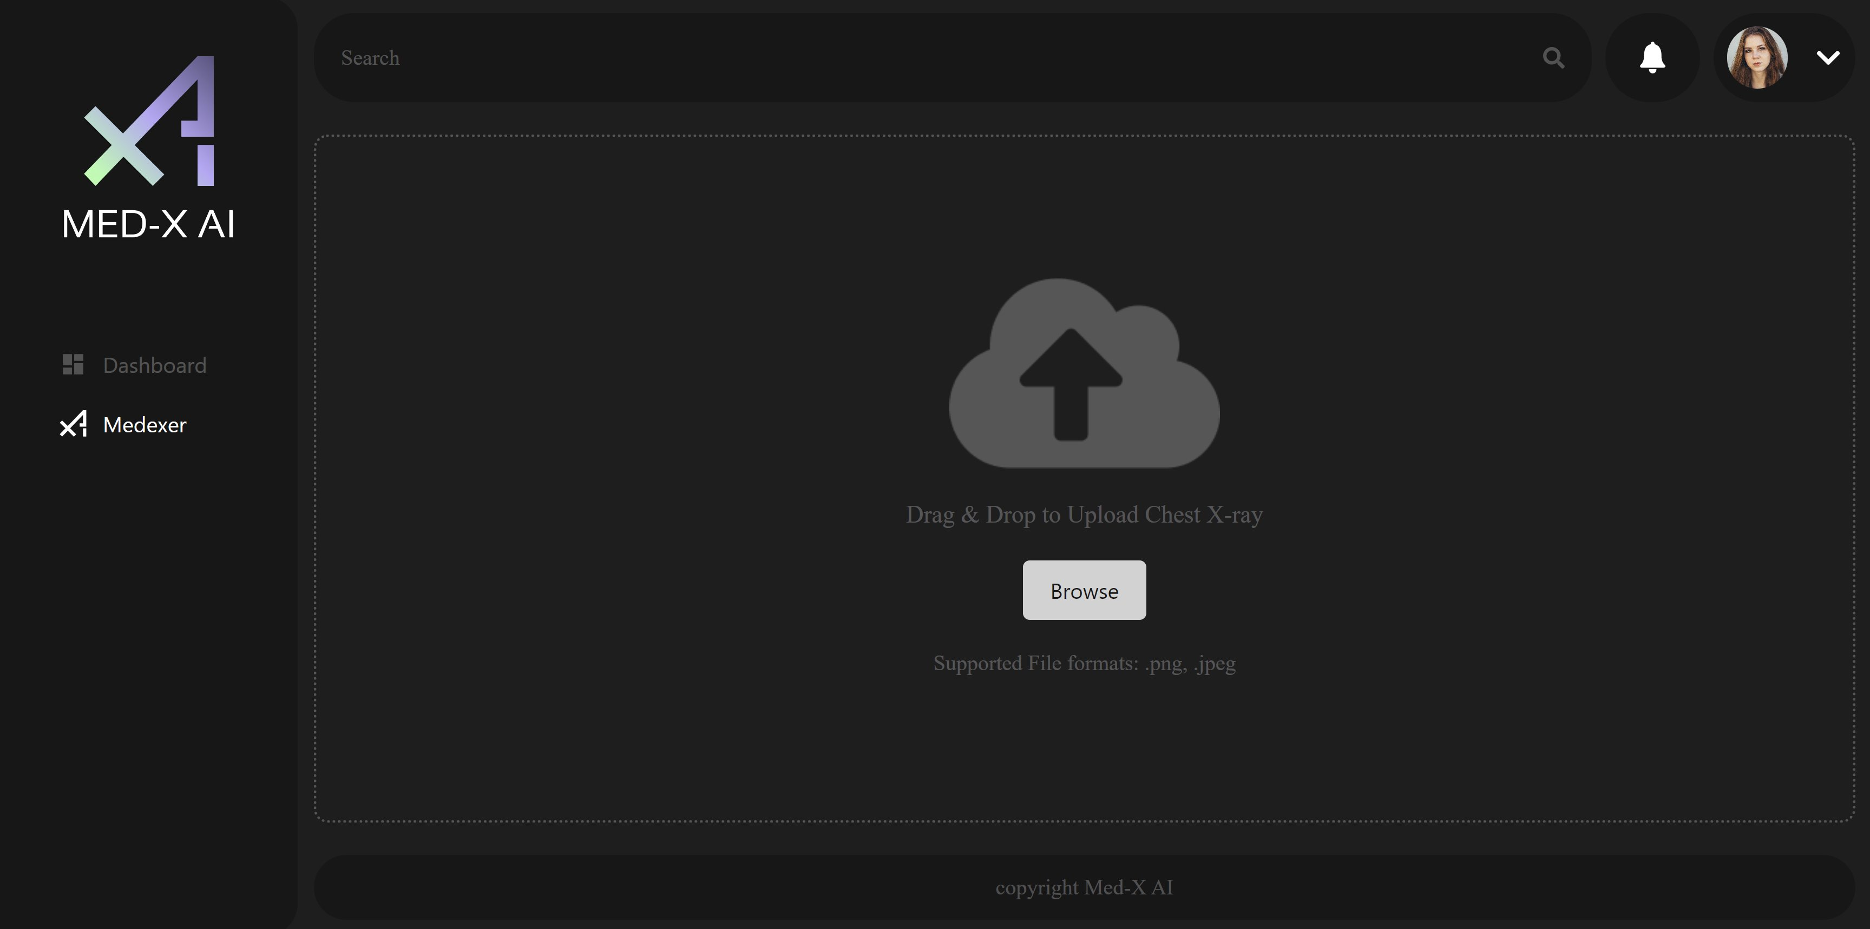
Application Screenshots:

Slide 69
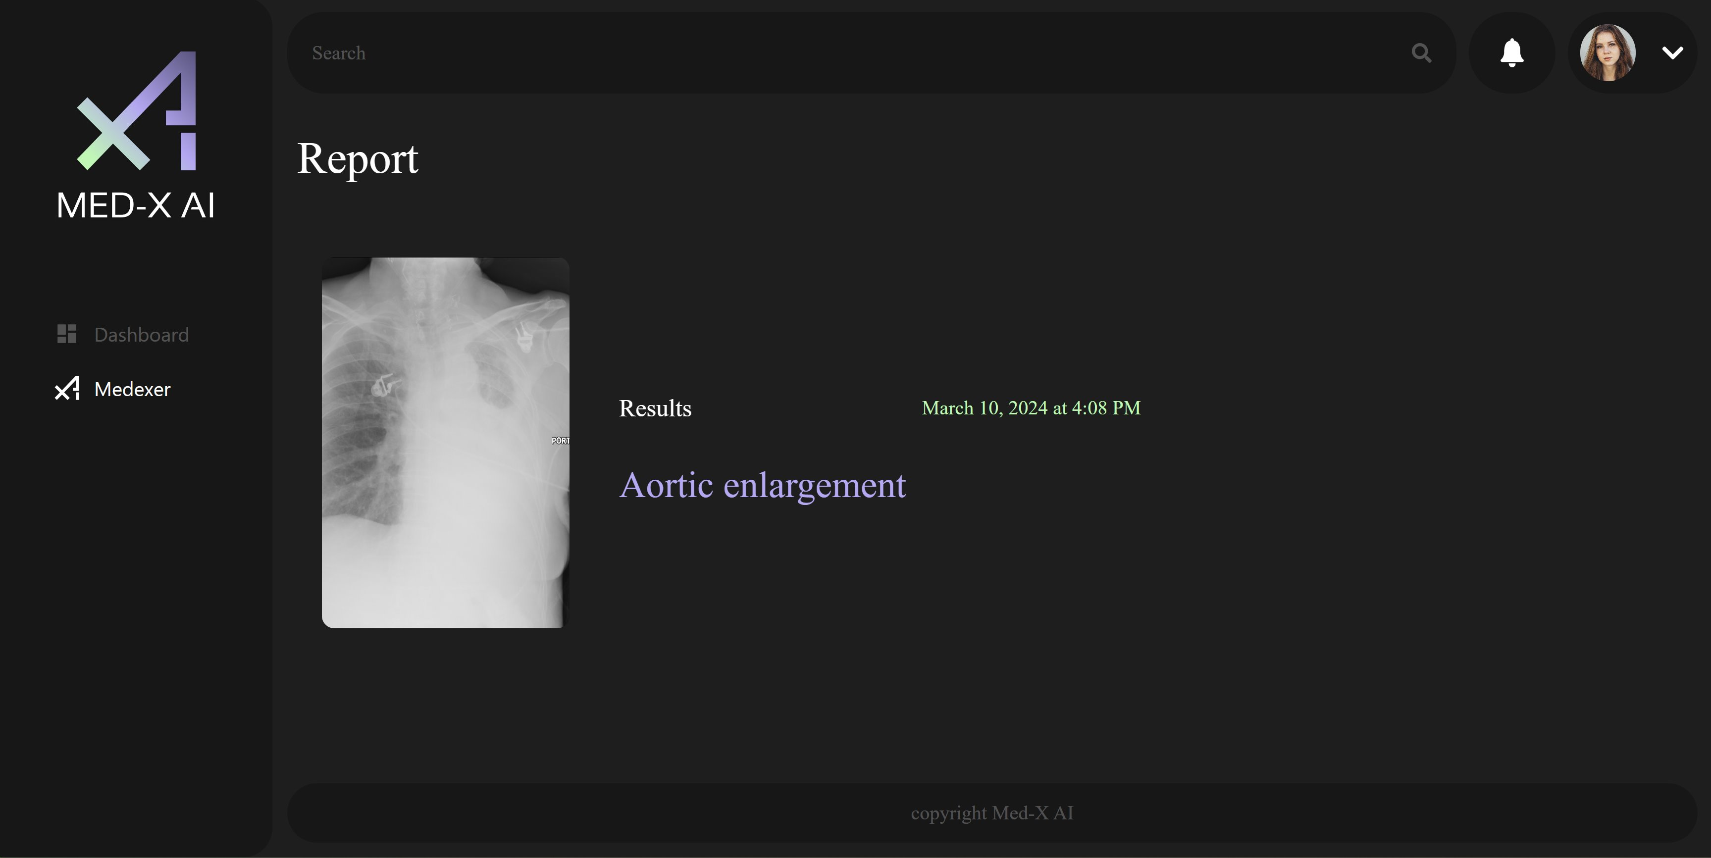
Application Screenshots:

Slide 70
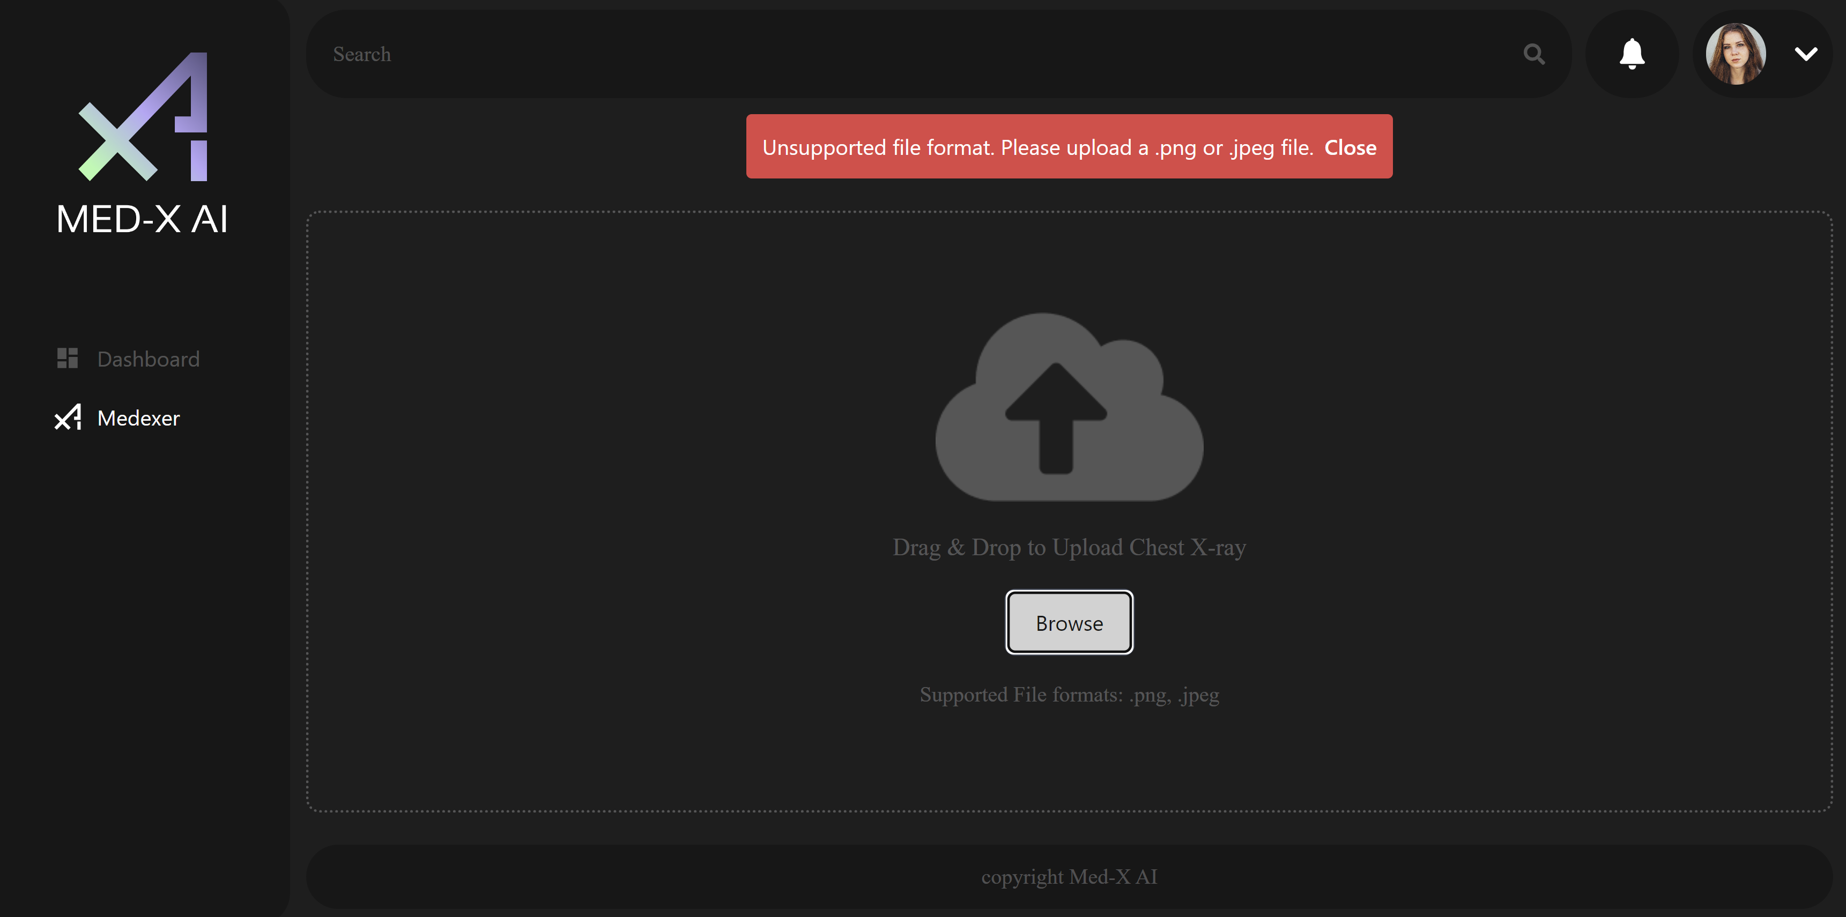
Application Screenshots:

Slide 71
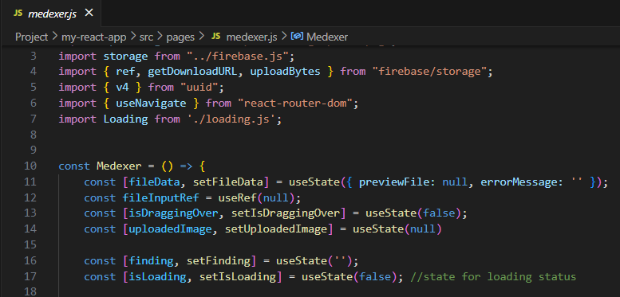
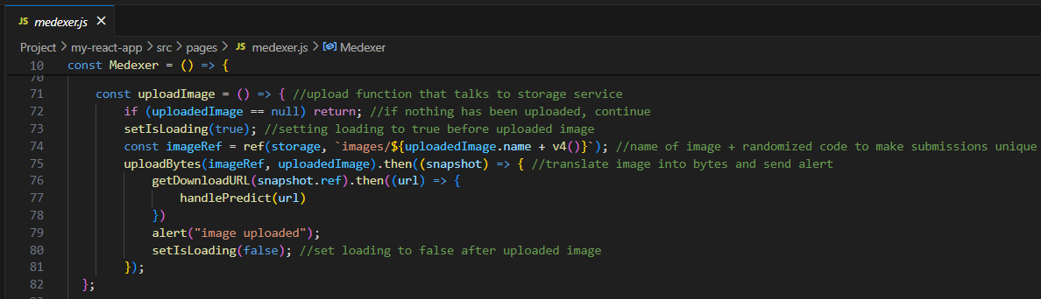
Firebase API:
Notes:
We chose Firebase over MongoDB because Firebase cloud services come with google APIs which allow our team to use our urls of our images with vast array of cloud services provided by Google and third-party providers.
In Medxer page, we import the apis to access Firebase's storage services like ref, getDownloadURL, and UploadBytes.
We use the first to create a reference from the storage service, the second to copy the google-generated api embedded inside the uploaded images urls for later use, and finally uploadBytes generates the url of the uploaded image by converting the JavaScript object into bytes.

Slide 72
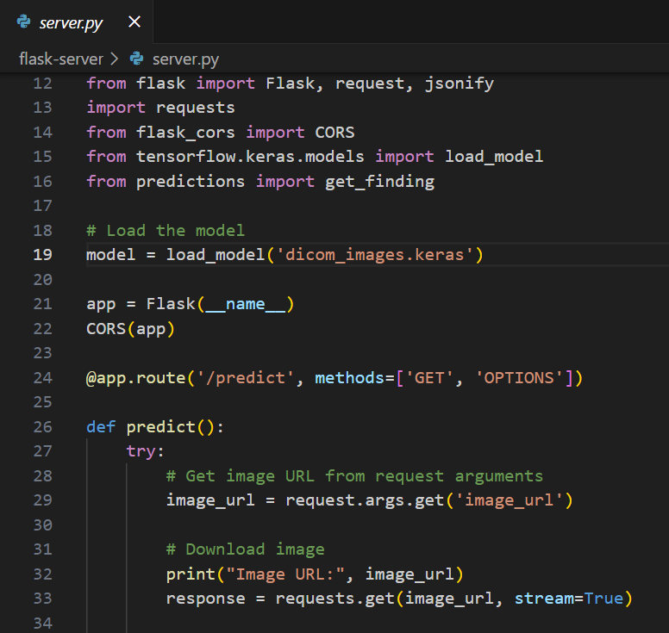
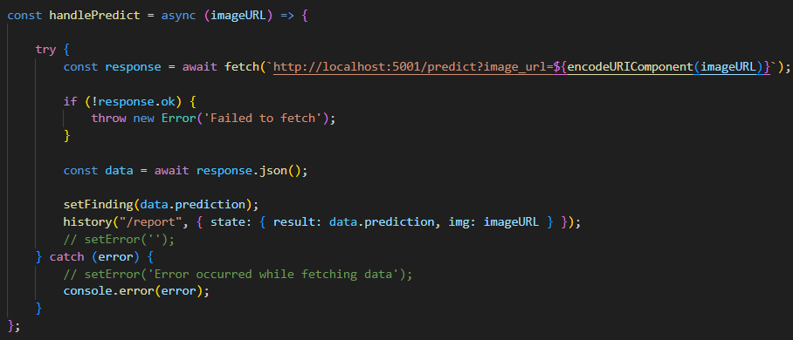
Flask/Cors:
Notes:
Advantages to using Flask:
Continuous Python runtime environment and library similar to NodeJS
The CORS class allows for direct exposure of the back-end service without using middleware like proxy.
Ease of use and customization of back-end services

Slide 73
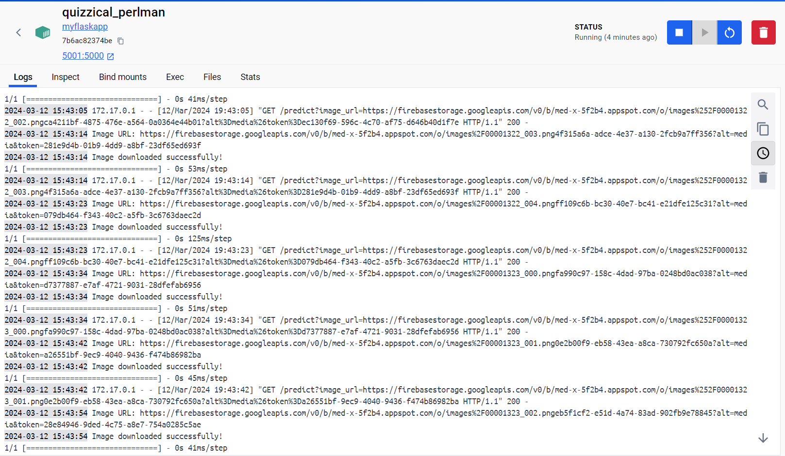
Docker for CI/CD:
Notes:
Dockerizing the back-end allowed our team to receive consistent test results on our machines because the app's dependencies are executed in a virtual environment based on a Linux kernel that encapsulates the Flask runtime environment for Python executables.
As you can see from the container's terminal view, the average response time for the back-end API response is twice as fast, the average speed is 59 ms, a considerable drop from 121 ms experienced in the Jupyter notebook in which we tested the neural network.

Slide 74
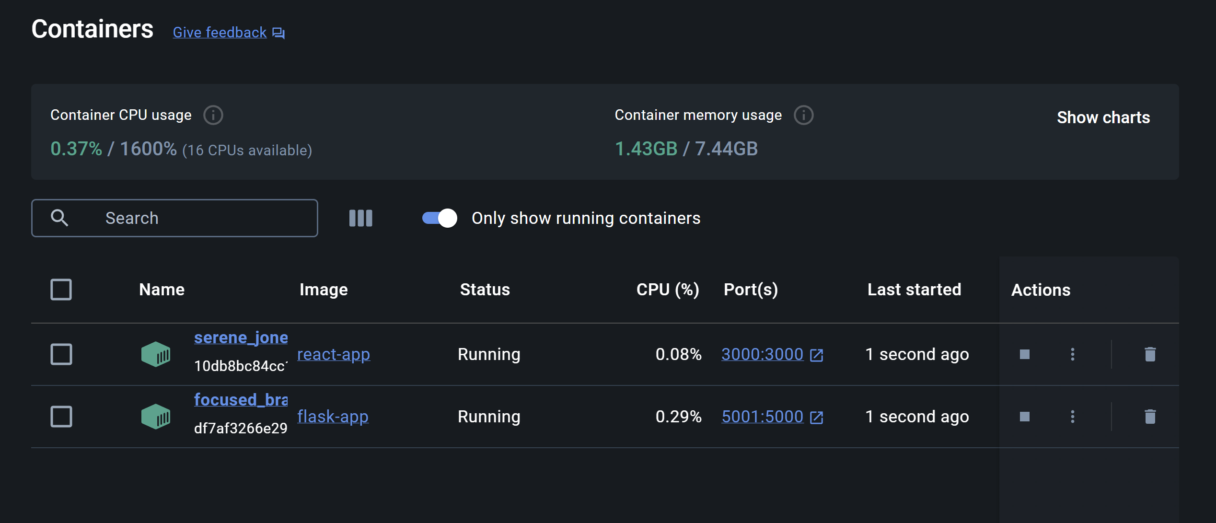
Docker:
Notes:
Perhaps, the greatest benefit of dockerizing both the front-end and back-end is booting into the application in seconds after clicking on the containers' ports instead of executing docker commands in our terminals.

Slide 75

Live Application Demo:

Slide 76
Next Steps:
Improve the Accuracy of the Neural Network Model using Feature Learning
Structured Printable / Downloadable Report of the Finding
Doctor's Comment
Report History / Searching a report

Slide 77
Wikipage Link
https://github.com/htmw/2024S-Med-X/wiki

Slide 78
Notes:
Do not delete this slide. It is a part of the animation for the 35th page.

